Slide 1
Level Of Pain Detection From Images
AZAZ JAmil 29329
Fatima akram 29330
Shahryar Mehmood 29415

Slide 2
Introduction
Pain is a natural phenomenon that indicates if the person is suffering from illness or has sickness. A person while enduring pain interprets their feelings and emotion. Due to severe medical conditions sometimes, patients are not in the condition to tell information about their health and pain level.

Slide 3
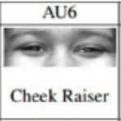
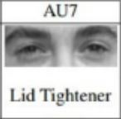

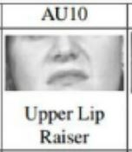
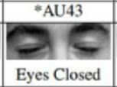
Dataset
Our dataset is based on facial images of patients suffering from shoulder pain. It consists on 25 patients and have almost 48000 images. Images are further classified into 10 classes. Pain level is labeled using Prkachin and Solomon Pain Intensity (PSPI) method. The method uses formula based on 4 Action Units(AU).
Pain=(AU4)+(AU6orAU7)+(AU9orAU10)+(AU43)

Slide 4
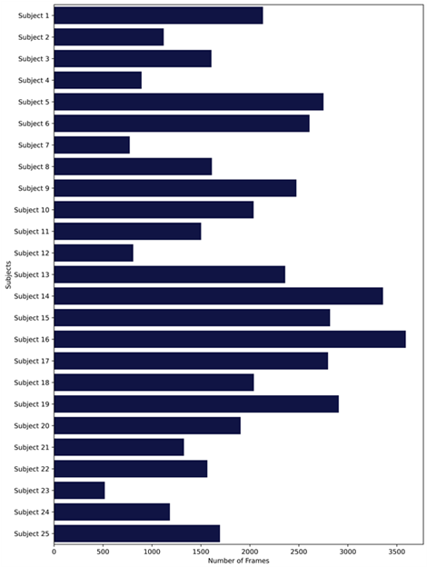
Data Analysis

Slide 5
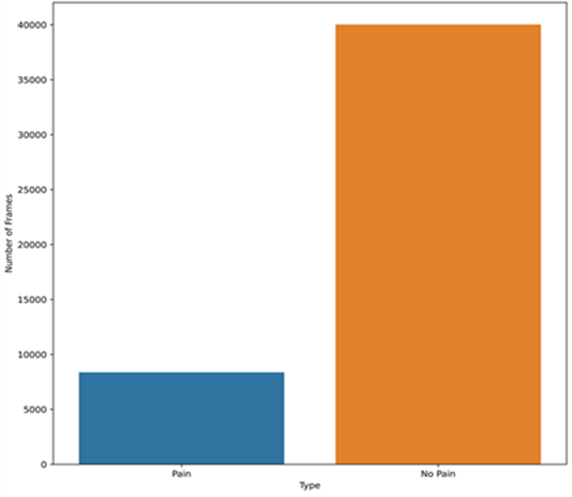
Image Distributions
Distribution of pain and no pain images

Slide 6
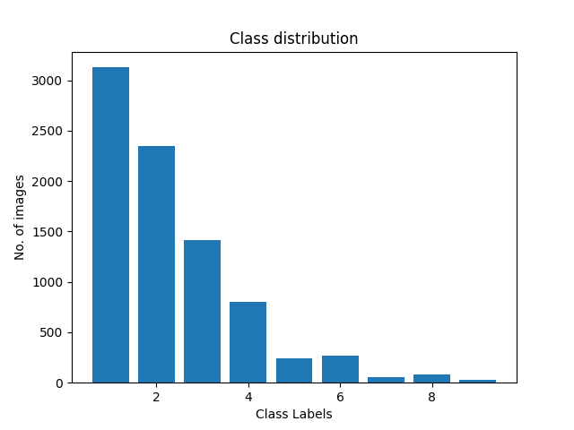
Images Distribution In 10 classes

Slide 7
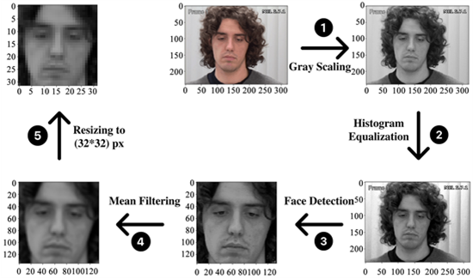
Data Preprocessing
Images are preprocessed before passing into model.

Slide 8
Models
CNN
A convolutional neural network (CNN) is a type of artificial neural network used primarily for image recognition and processing due to its ability to recognize pattern in images
VGG 16
The 16 in VGG-16 refers to 16 layers that have weights. In VGG16 there are 13 convolutional layers, 5 max pooling layers
And three dense layers which sums up to 21 layers, but it has only 16 weight layers

Slide 9
Models And Accuracy
Testing accuracy for 10 classes
VGG-16 | Customized CNN
12.61% accuracy | 31% accuracy
Testing accuracy for binary classes
VGG_16 | Customized CNN
73% accuracy | 55% accuracy

Slide 10
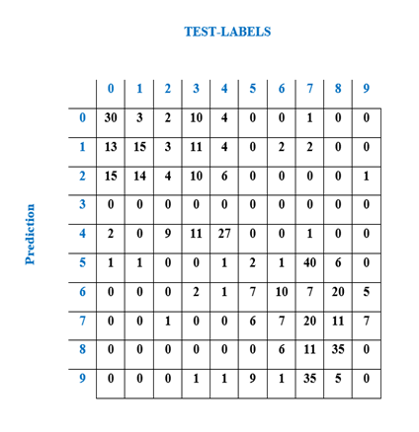
Confusion Matrix For 10 Classes

Slide 11
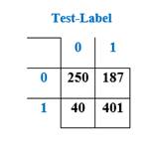
Confusion Matrix For Binary Classes

Slide 12










SAMPLE DATA

Slide 13
THANKYOU

